Slide 1
Persistency & Rider Attachment ratio Analysis

Slide 2
Content
Reference
Group Long-Term Disability Experience Study
Model Introduce & Predict Results (Group1,Group3)
Explore Data Analysis
Persistency
Rider Attachment ratio
Future Goals
Time Series Analysis

Slide 3
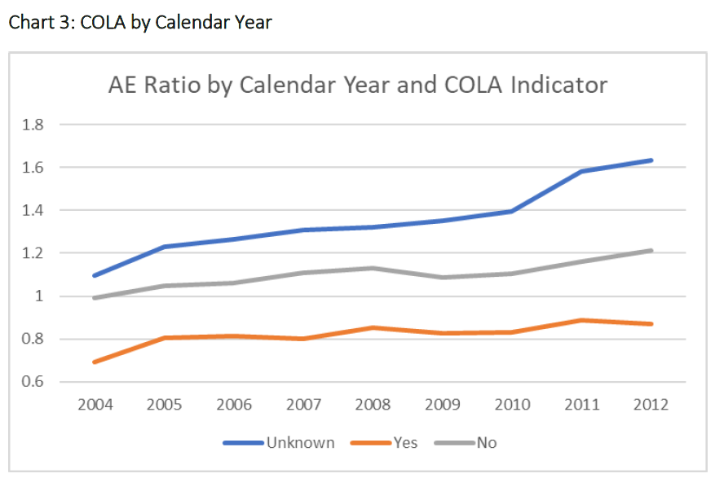
1. References
$$\frac{Actual Recovery Rate}{Expected Recovery Rate}$$

Slide 4
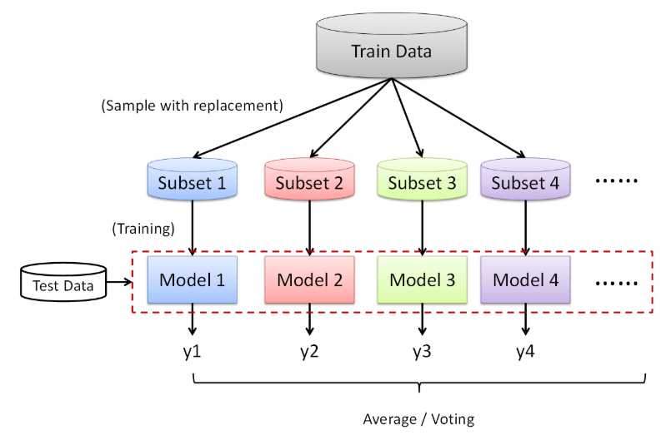
1. Methodology

Slide 5
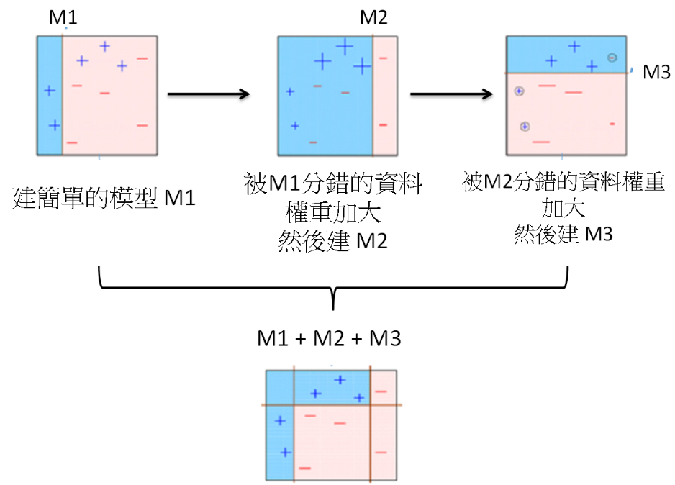
1. Methodology

Slide 6
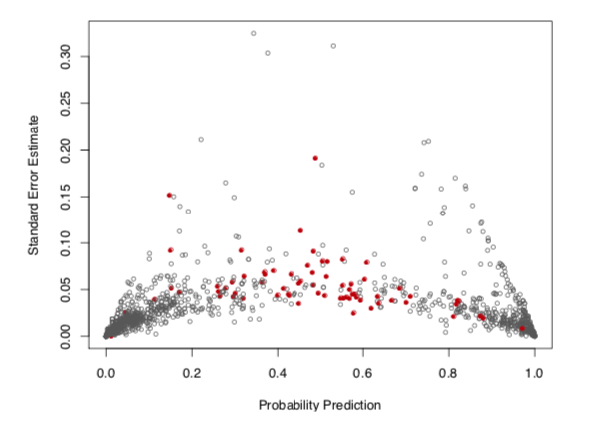
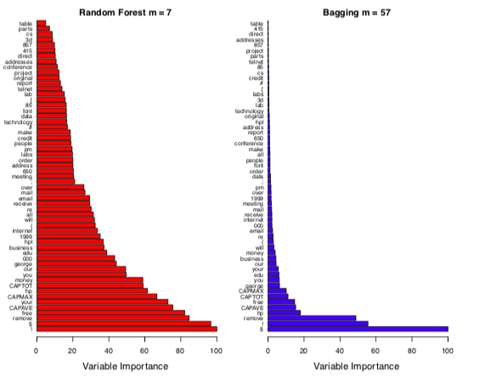
1. Predict Valuation

Slide 7
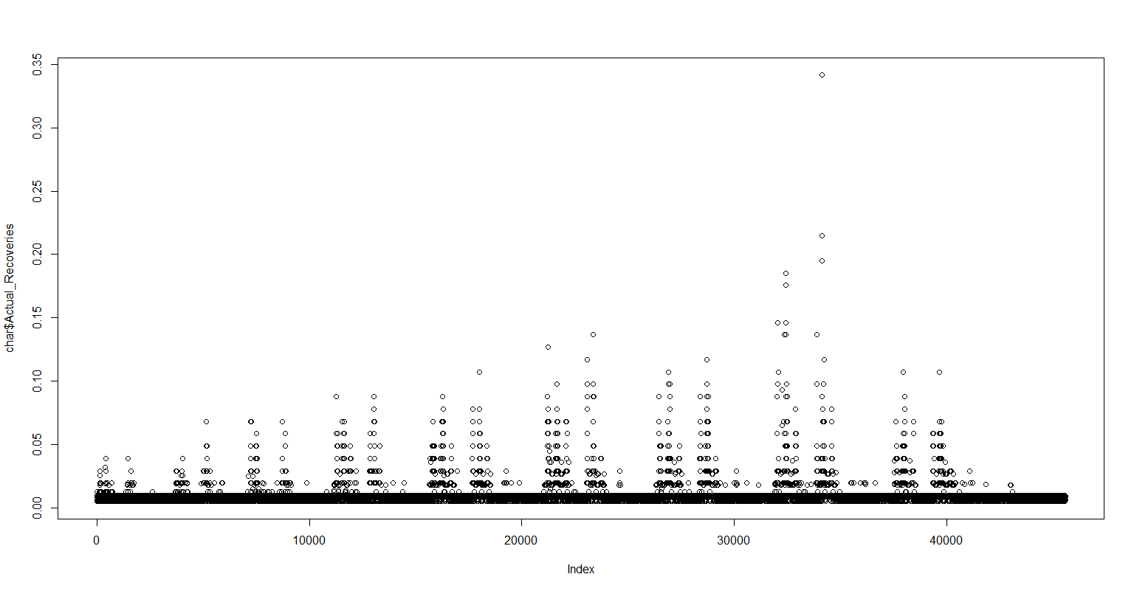
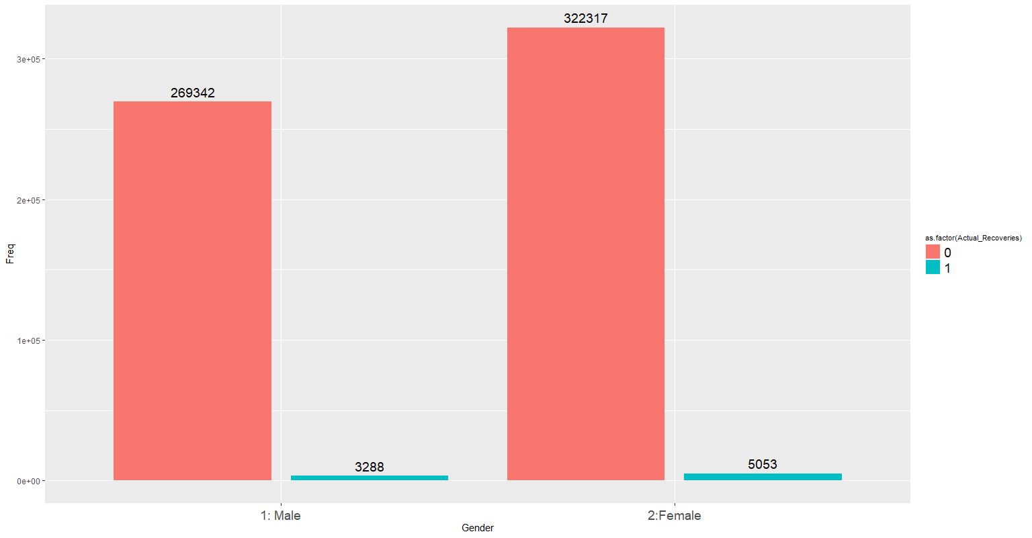
1. Target Variable : Actual Recoveries
Group 1 Data
Group 3 Data

Slide 8
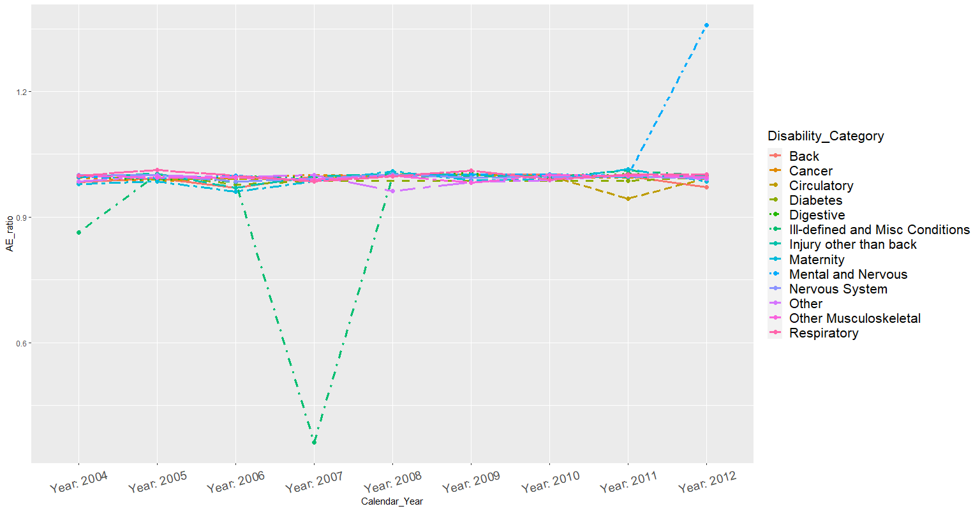
1. Group 1 Results from Gradient Boosting

Slide 9
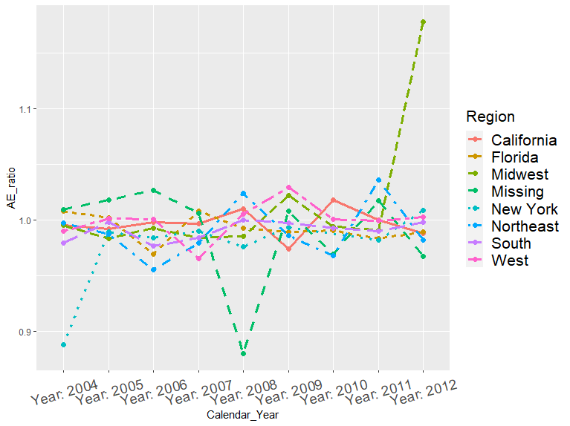
1. Group 1 Results from Gradient Boosting

Slide 10
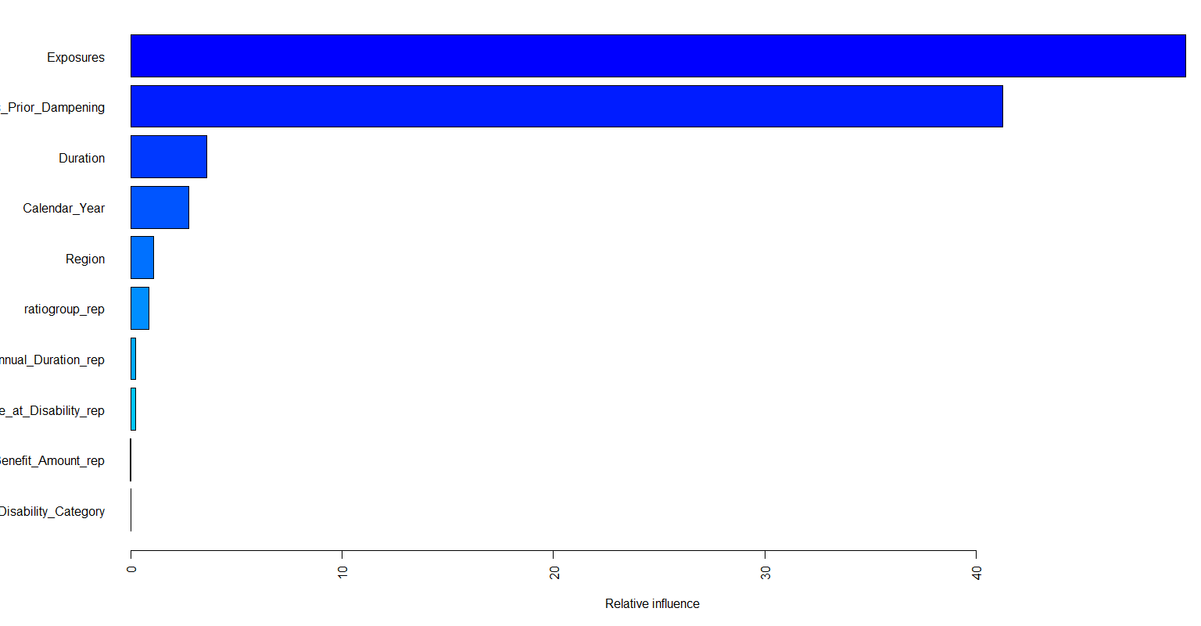
1. Group 1 Results Importance Plot

Slide 11
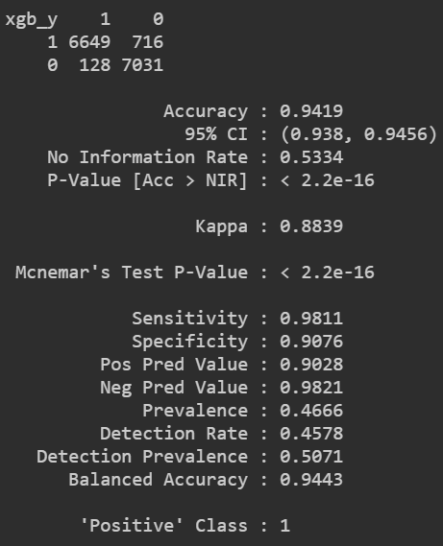
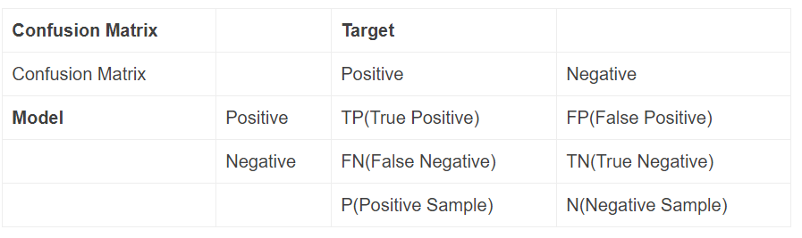
1. Group 3 Results from Gradient Boosting
Sensitivity (靈敏度)：True Positive Rate (TPR)
Specificity (特異度) : True negative rate (TNR)
Balanced Accuracy = (Sensitivity+Specificity)/2

Slide 12
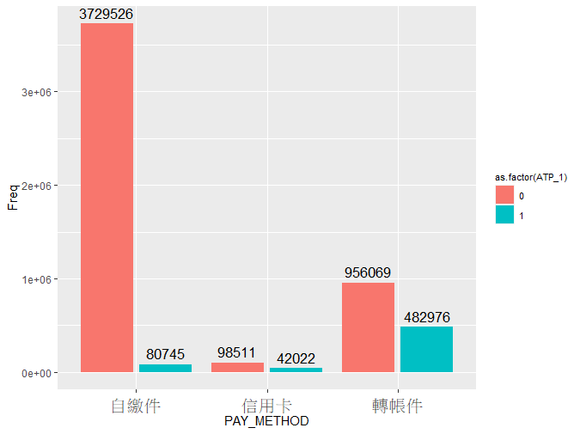
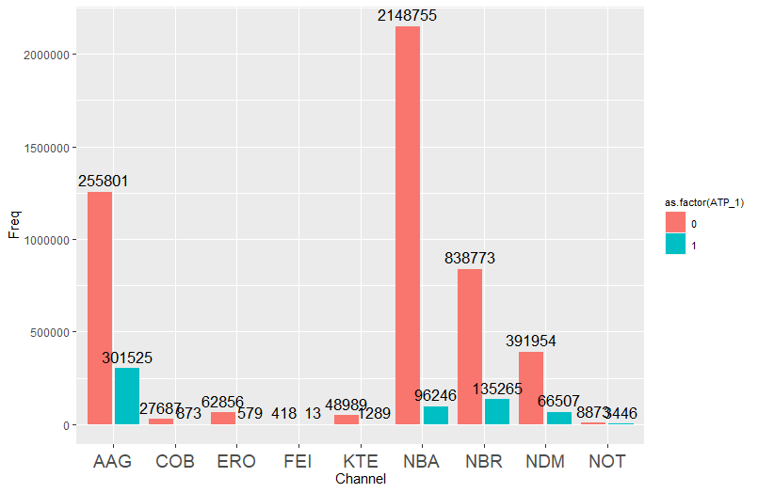
2. Explore Data Analysis (Persistency)

Slide 13
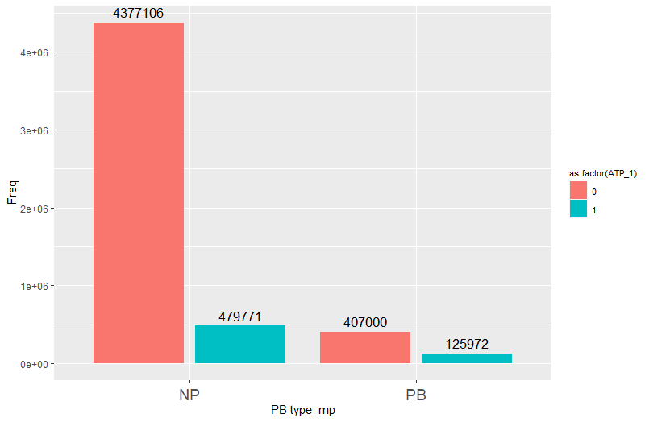
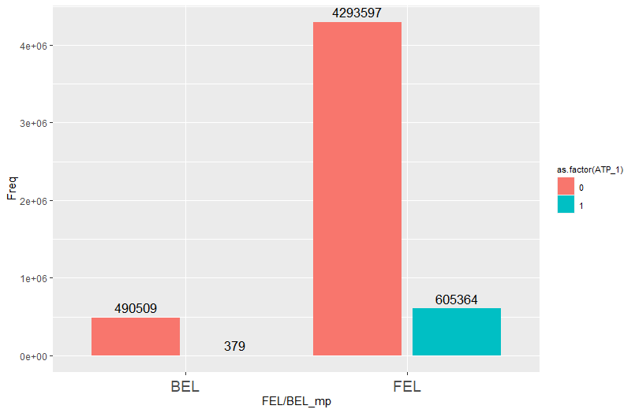
2. Explore Data Analysis (Persistency)

Slide 14
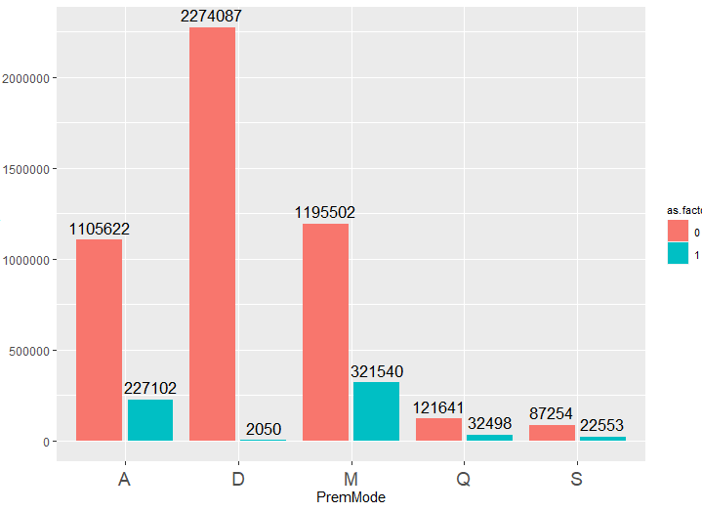
2. Explore Data Analysis (Persistency)

Slide 15
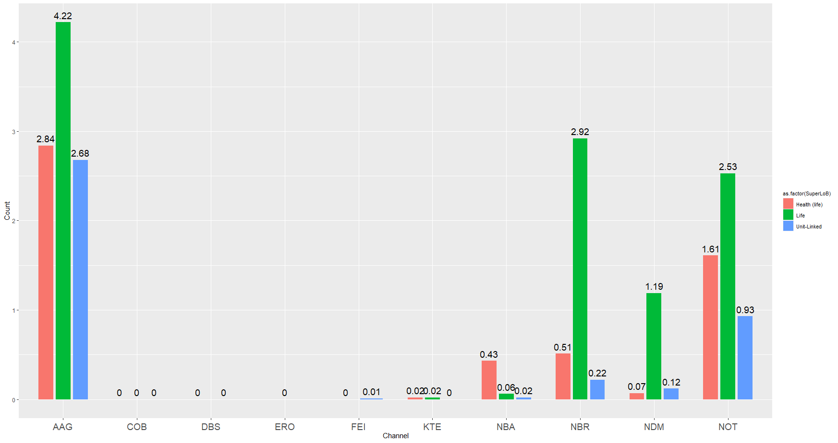
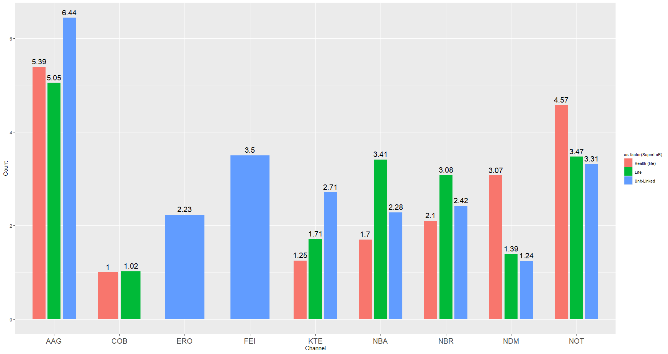
2. Explore Data Analysis (Rider Attachment ratio)
Include No Rider Master
Exclude No Rider Master

Slide 16
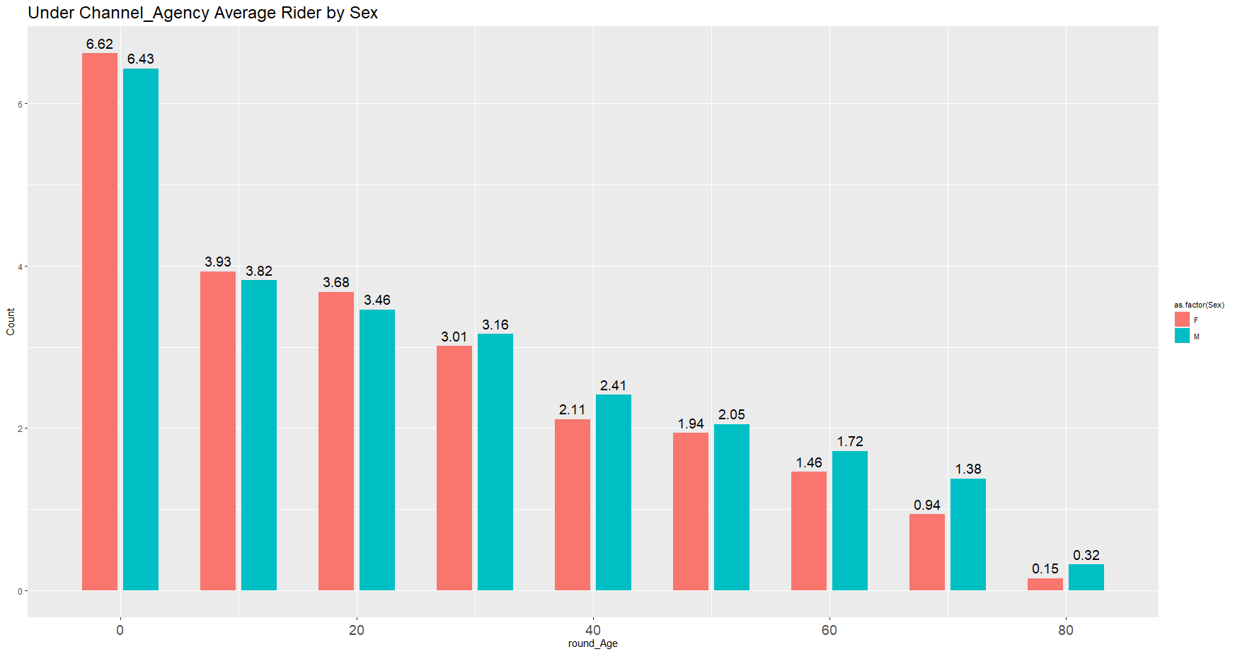
2. Explore Data Analysis (Rider Attachment ratio) (AAG)

Slide 17
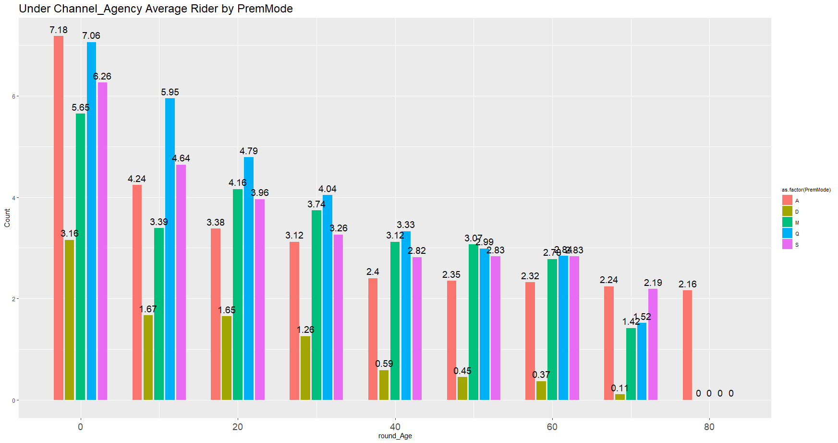
2. Explore Data Analysis (Rider Attachment ratio) (AAG)

Slide 18
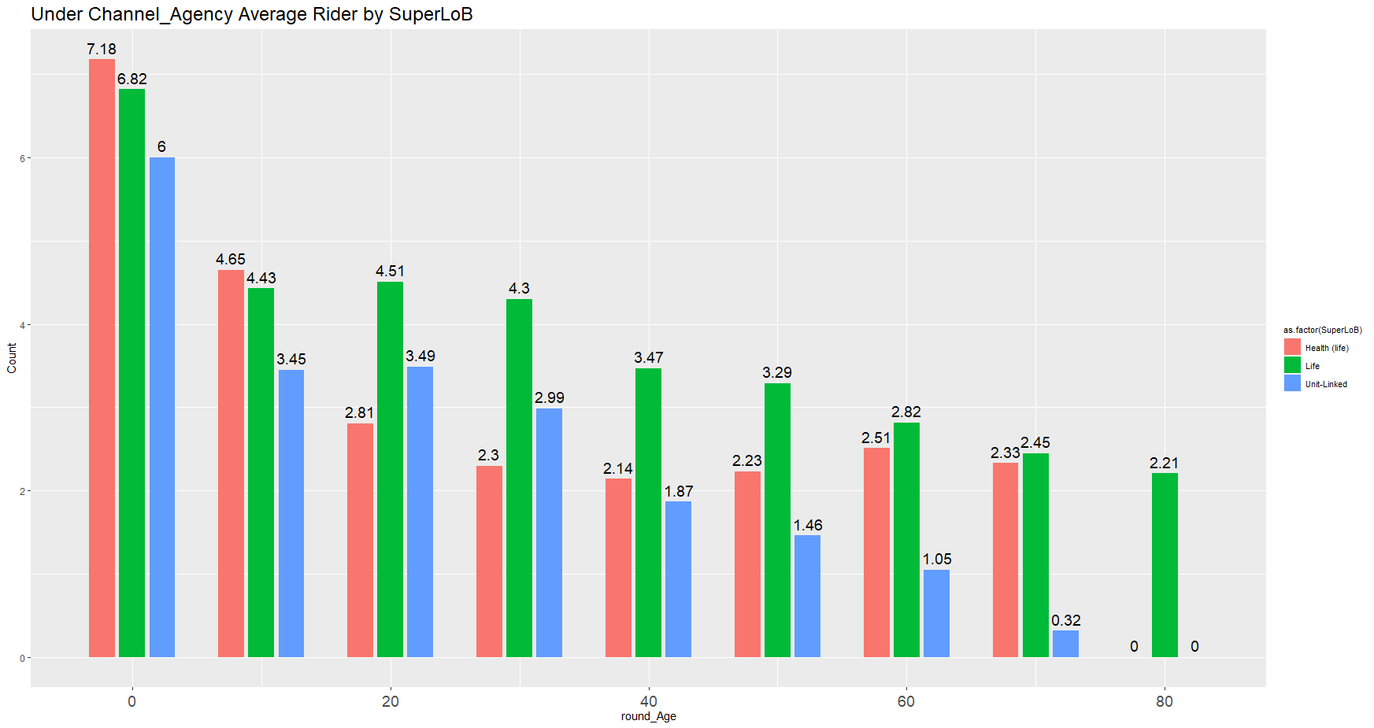
2. Explore Data Analysis (Rider Attachment ratio) (AAG)

Slide 19
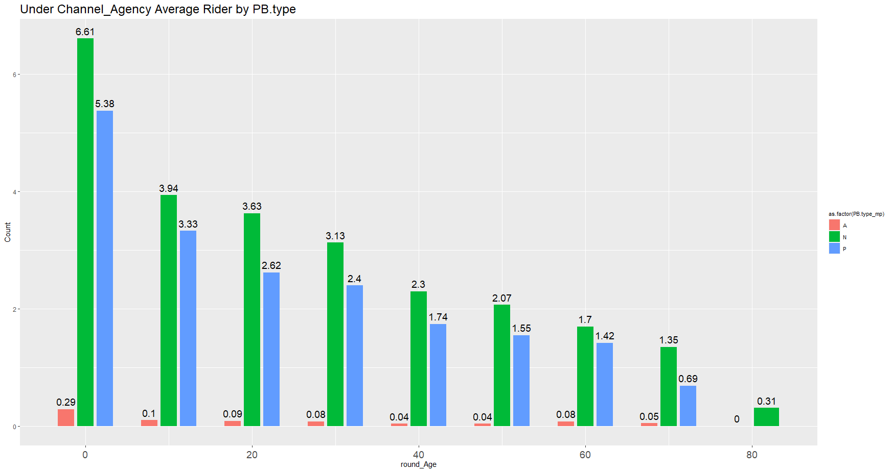
2. Explore Data Analysis (Rider Attachment ratio) (AAG)

Slide 20
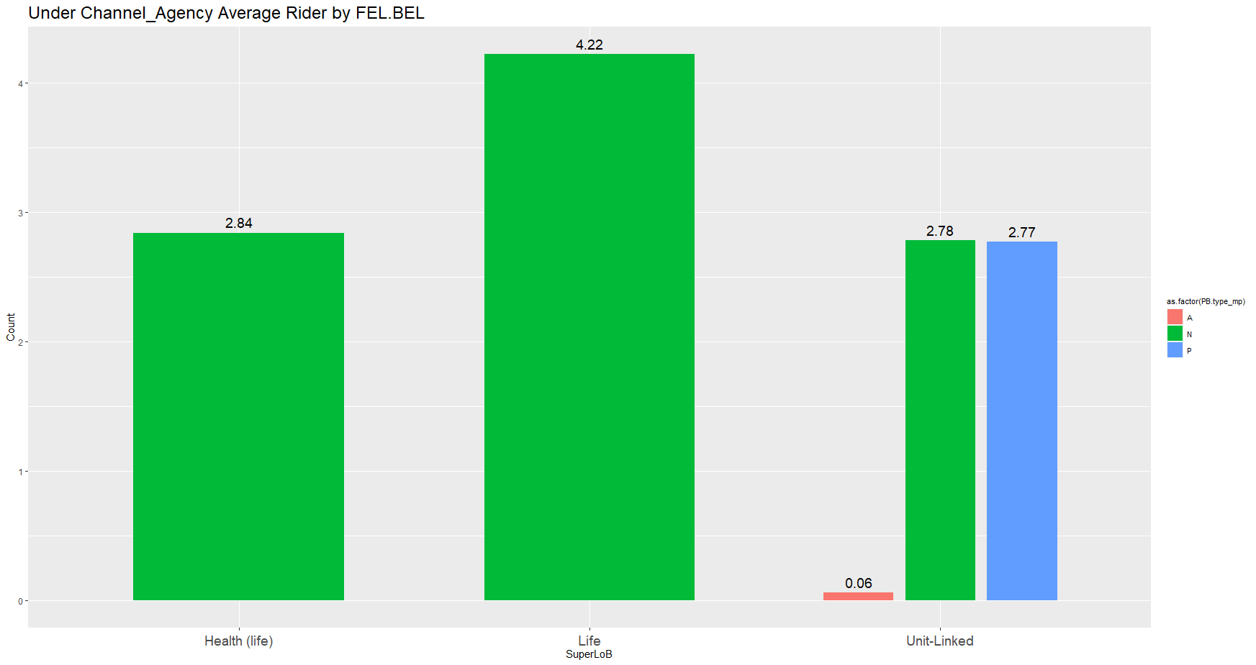
2. Explore Data Analysis (Rider Attachment ratio) (AAG)

Slide 21
stability
3. Future Goals
Time Series Analysis
Impluse Response：Whether have Lead-Lag effect between variables.
Stability Test： Whether variables in the same time structure.
Time Series Model Fit

